Slide 1
The Velveteen Rabbit
Final Lighting Design Presentation

Slide 2
Launch Points…
…or How Toys Become Real
The Transformative Power of Imagination
The Transformative Power of Nursery Magic

Slide 3
Real
Reality may be Dramatic and Theatrical
Reality is the Spark for Imagination
Historical Sparks for Our Imagination

Slide 4
Vintage Lamps What do you See?

Slide 5
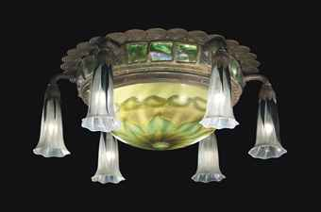
Set in the 1920’s… Décor from Earlier

Slide 6
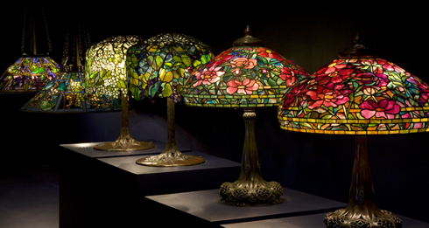
Period Practicals Tiffany Lamps

Slide 7
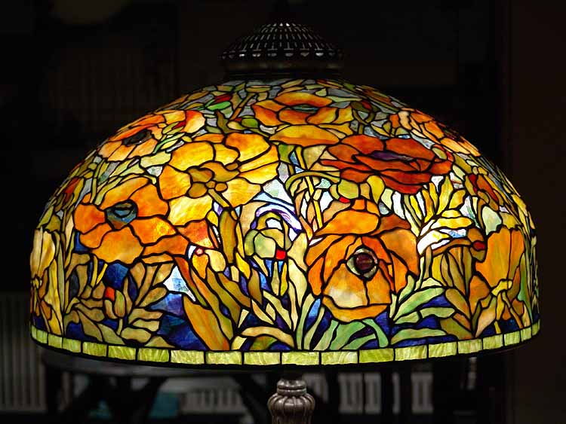
How would this color a Child’s Imagination?

Slide 8
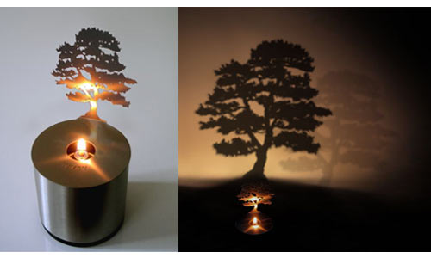
Sparks in the World around us

Slide 9
Sparks in the World around us

Slide 10
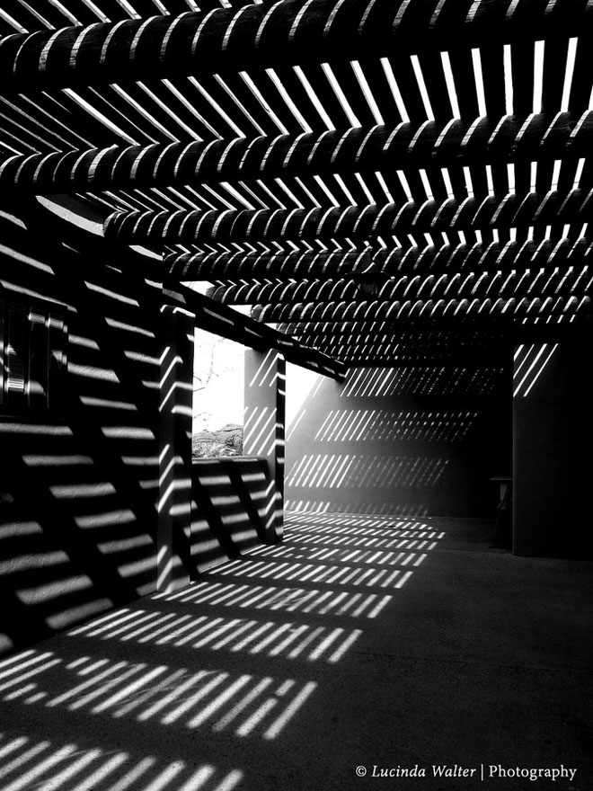
Sparks in the World around us

Slide 11
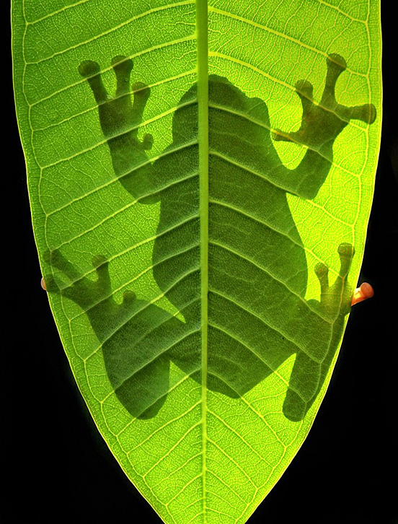
Sparks in the World around us

Slide 12
Sparks in the World around us

Slide 13
Imagination is…
Dramatic/Theatrical
Colorful
Unapologetic
Limitless and Unconstrained

Slide 14
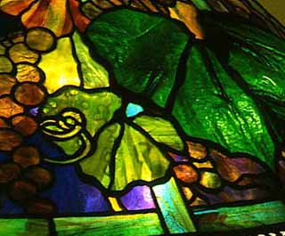
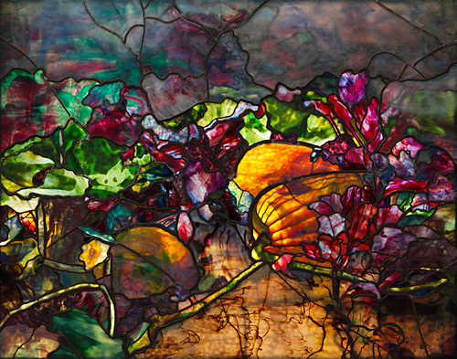
Tiffany Glass

Slide 15
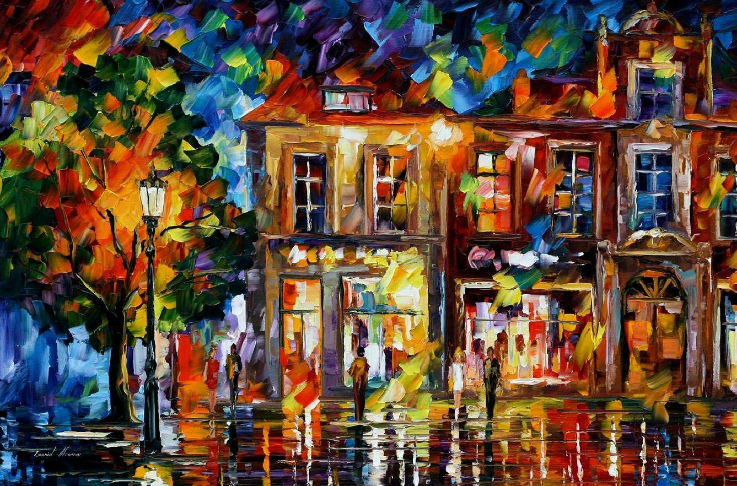
Full Blown Imagination… Every Crayon in the Box

Slide 16
Nursery Magic is…
Like Imagination but…
More Mature and Sophisticated
Powerful

Slide 17
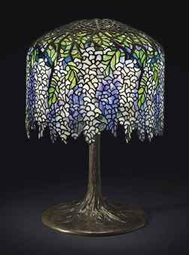
Tiffany Lamp (Again)

Slide 18
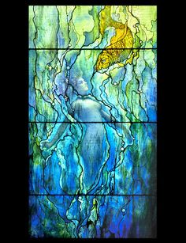
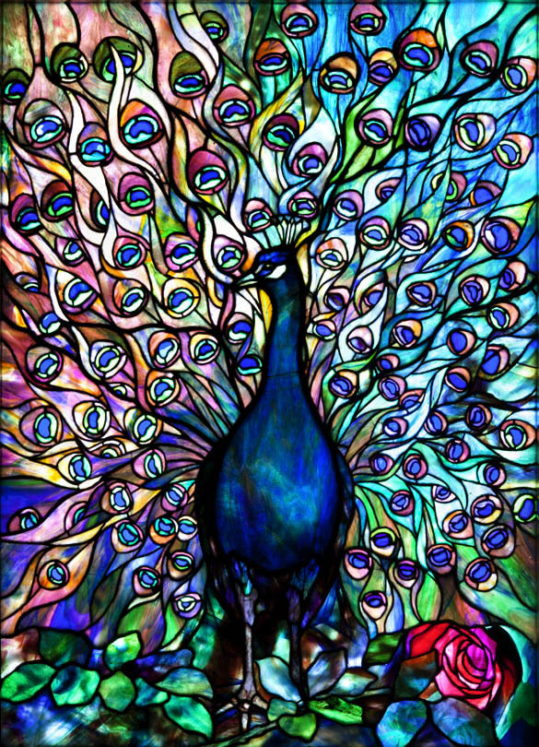
Tighter Color Pallet

Slide 19
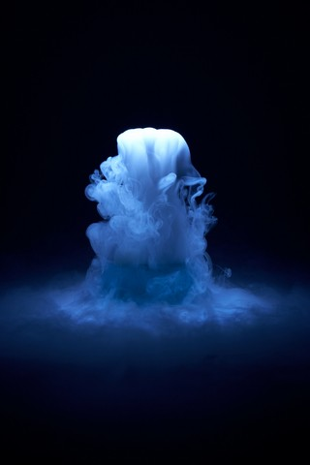
Smoke and Dry Ice Fog

Slide 20
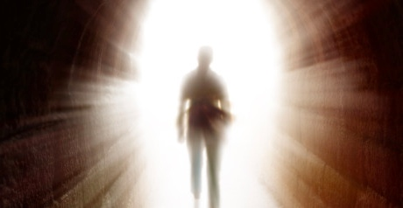
Transformation to Real

Slide 21
