Slide 1
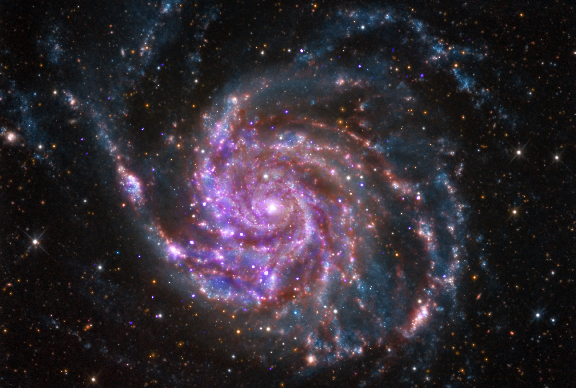
Galileo Galilei
The Bible teaches us how to go to heaven, not how the heavens go.
- Cardinal Ceaser Baronius

Slide 2
Then and Now
Differences
Similarities
Simple
Primitive understanding
Dogma
Dawn of Scientific Revolution
Dawn of Experimentation and Proof
Primitive technology
Light = Sun, Moon, Stars, Candles, Lanterns.
Invention of non-naked eye observation
Longing for Understanding
Sense of wonder regarding the Heavens (Cosmos and Spiritual)

Slide 3
Before we invented civilization our ancestors lived mainly in the open out under the sky. Before we devised artificial lights and atmospheric pollution and modern forms of nocturnal entertainment we watched the stars. There were practical calendar reasons of course but there was more to it than that. Even today the most jaded city dweller can be unexpectedly moved upon encountering a clear night sky studded with thousands of twinkling stars. When it happens to me after all these years it still takes my breath away. ― Carl Sagan, Pale Blue Dot: A Vision of the Human Future in Space

Slide 4
Opposing Forces
Darkness vs. Light
Light = Understanding and Vision
As understanding and vision fade, the world is smaller and darker
Heavens: Spirit and Heavens: Cosmos
Cosmos = Stars
Spiritual = Stained Glass

Slide 5
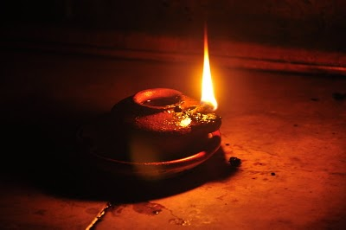
Candlelight and Lamplight

Slide 6
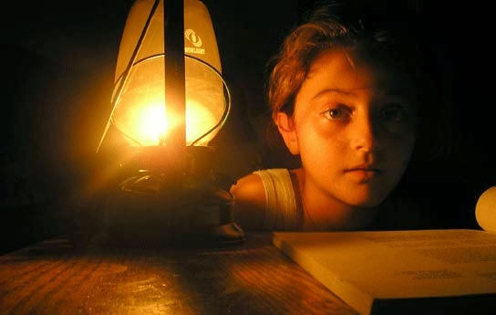
Candlelight and Lamplight

Slide 7
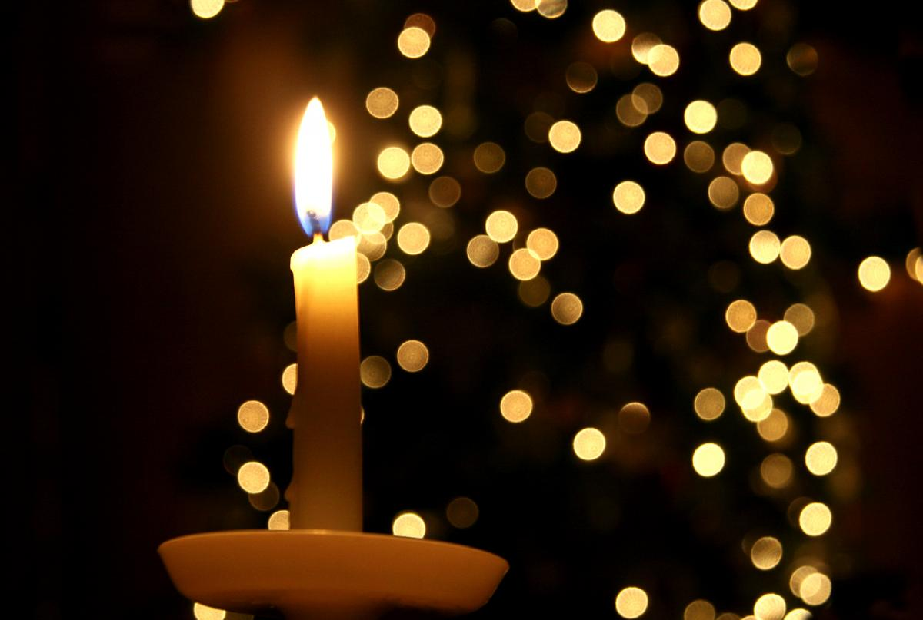
Candlelight and Lamplight

Slide 8
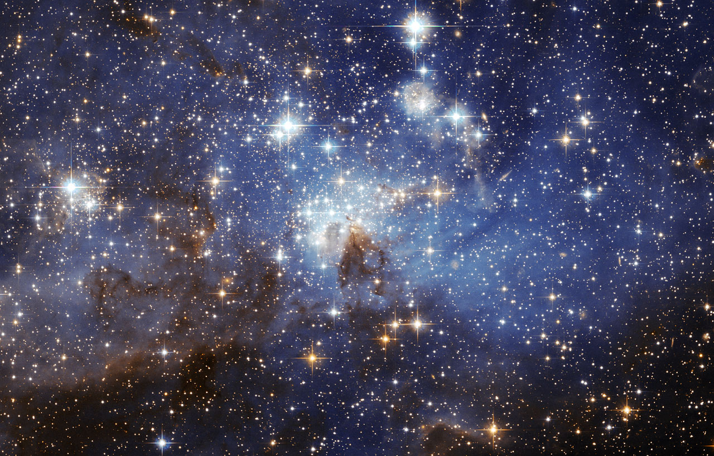
Heavens w/vision

Slide 9
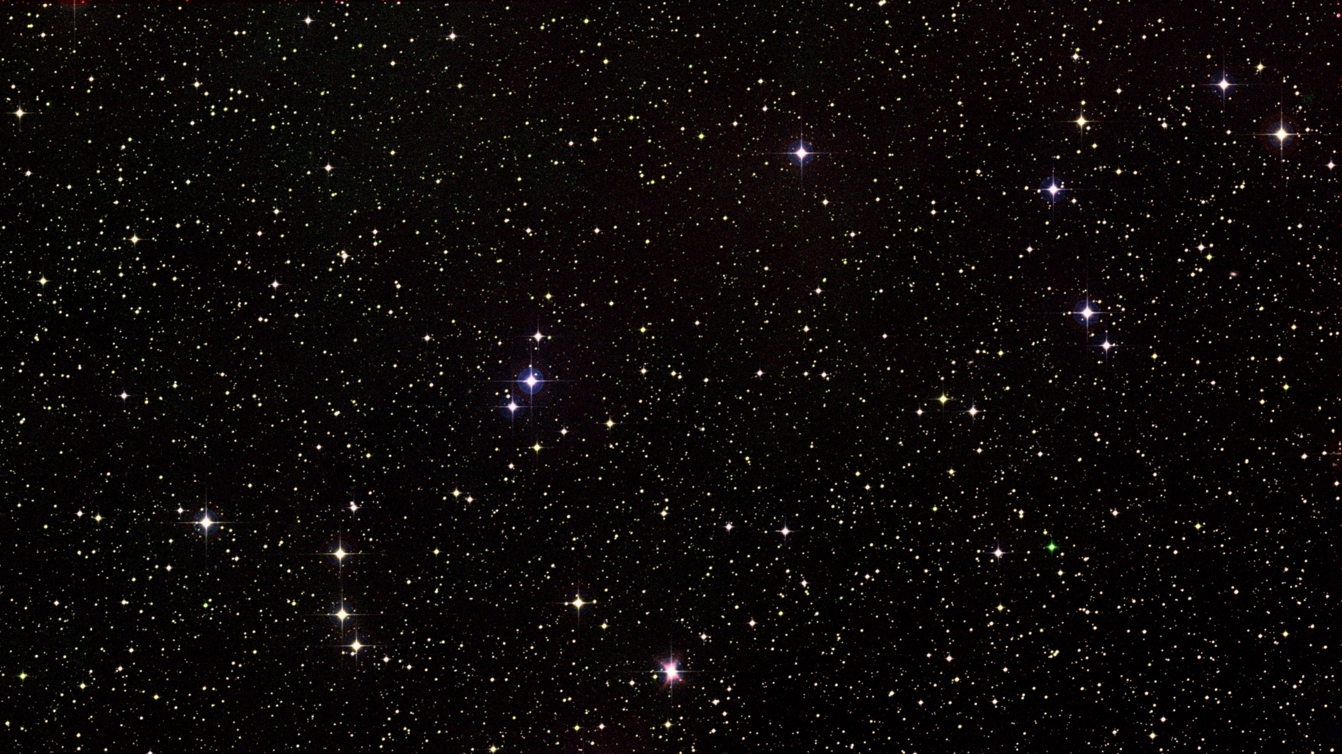
Heavens w/partial vision

Slide 10
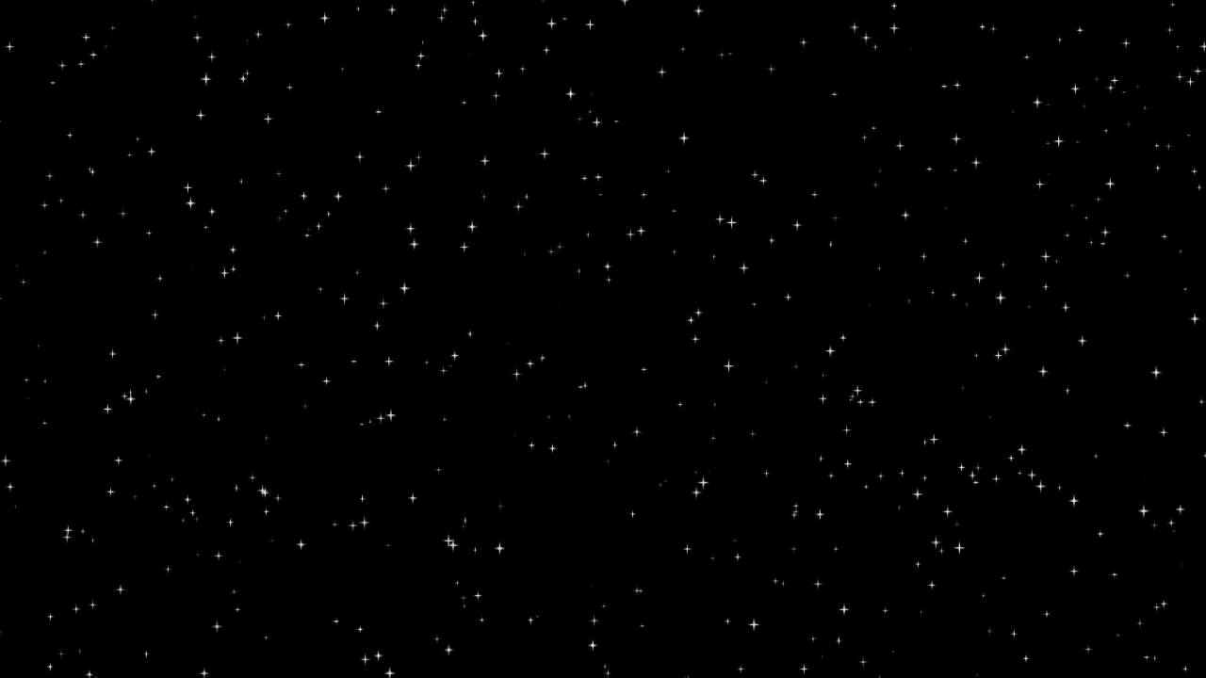
Heavens w/o vision

Slide 11
Heavens Progression

Slide 12
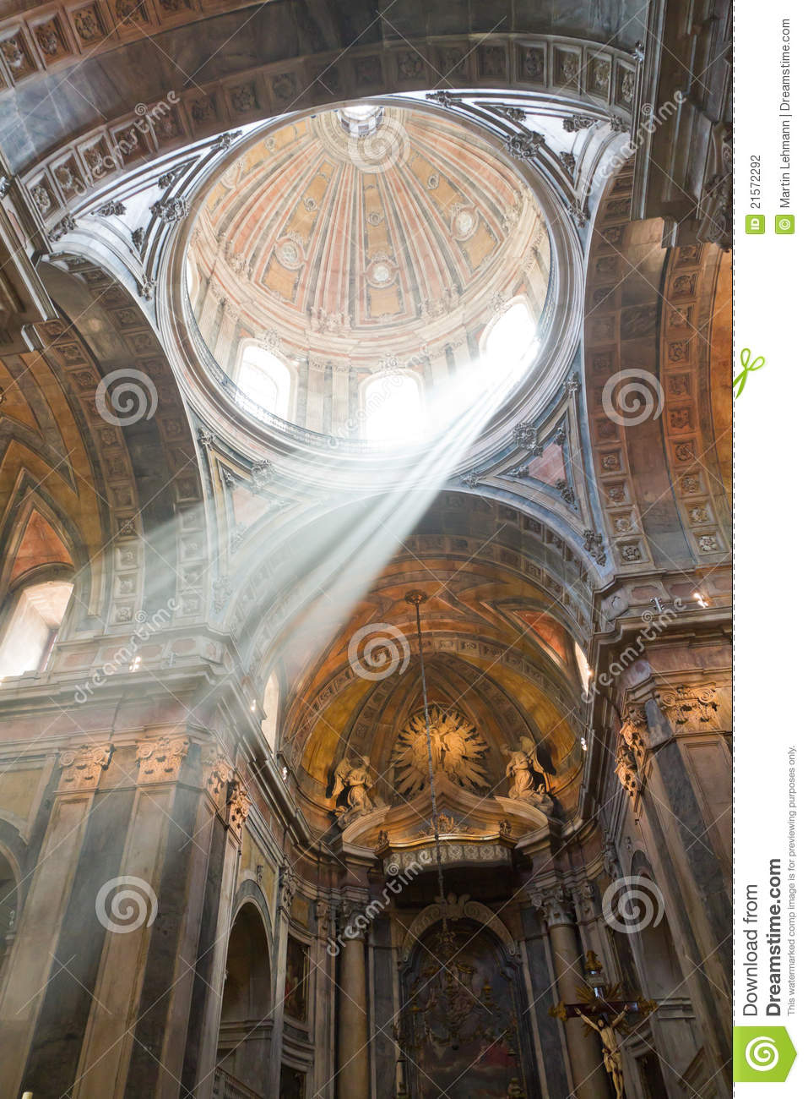
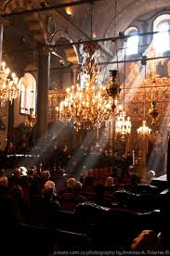
Church Light

Slide 13
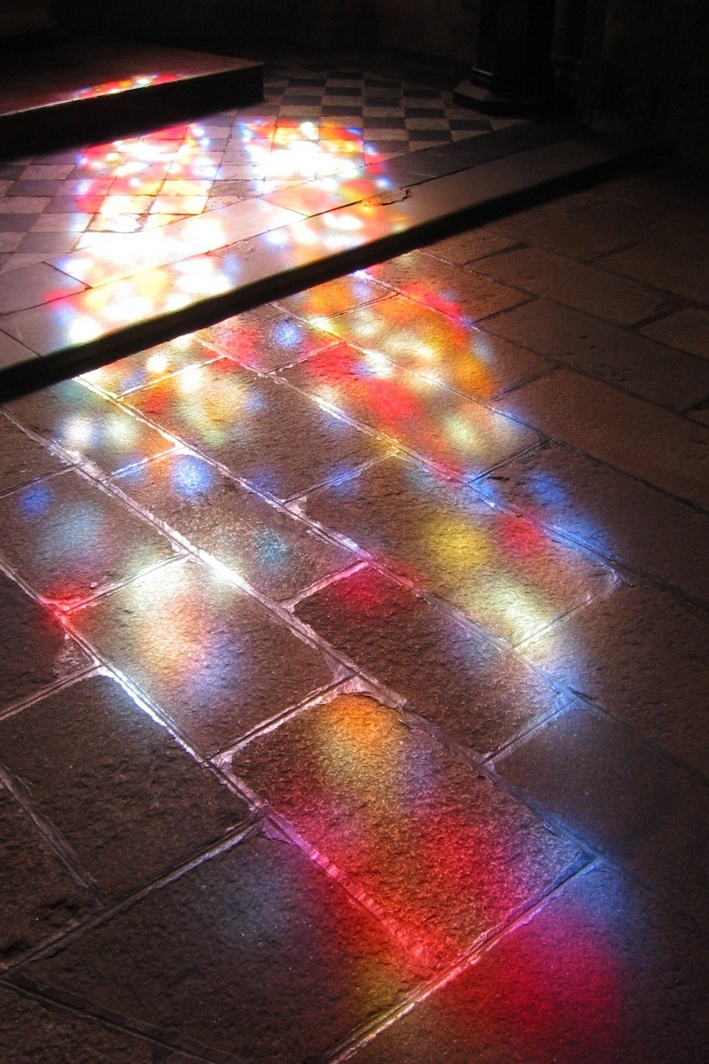
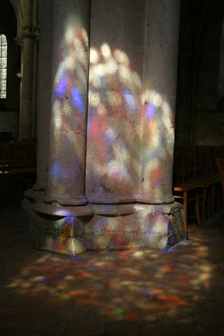
Church Light

Slide 14
Cornerstones of the Lighting
Candle/Lamp Light
Primitive and Simple
Color, angle, movement
Star Fields
Primitive, Simple, and Wondrous
Star drops and projections
Shafts of natural light
From Very High (Heaven)
Through Stained Glass (Wondrous)
Recede into Darkness

